Slide 1
Cognitive Linguistics in the Year 2015
Laura A. Janda
laura.janda@uit.no

Slide 2
2 Cognition and Language
cognitive linguistics makes a minimum of assumptions
linguistic facts should be explained with reference to general cognitive mechanisms otherwise established by neurobiologists and psychologists
language is built from actual usage events (“performance”)

Slide 3
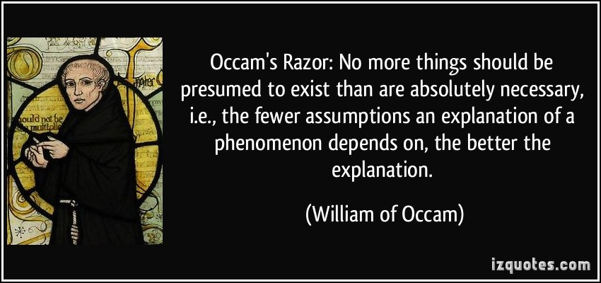

Slide 4
What cognitive linguistics does NOT assume:
Minimal Assumption: language can be accounted for in terms of general cognitive strategies
no autonomous language faculty
no strict division between grammar and lexicon
no a priori universals
Usage-Based: generalizations emerge from language data
no strict division between langue and parole
no underlying forms
Meaning is Central: holds for all language phenomena
no semantically empty forms
differences in behavior are motivated (but not specifically predicted) by differences in meaning
metaphor and metonymy play a major role in grammar

Slide 5
Language & Cognition
Linguistic cognition has no special status
All linguistic phenomena can be explained via general cognitive mechanisms
Language is not divided into discrete levels or modules
phonology, morphology, syntax and lexicon form a continuous phenomenon
primary motive for all linguistic phenomena is meaning

Slide 6
Some General Cognitive Mechanisms
Perception, selective focusing of attention
construal, profiling
High connectivity, overlapping functions
radial category structure
redundancy
Mapping, connections between neural nets
metaphor
metonymy
blending

Slide 7
3 The Status and Source of Meaning
Meaning underwrites the existence of all linguistic units and phenomena, none of which are semantically empty
Grammar is an abstract meaning structure that interacts with the more concrete meanings of lexicon
Meaning is grounded in the shared human experience of bodily existence
All experience is filtered by perception; as a consequence language is not a description of the real world, but rather a description of human perception of reality
The same event of objective reality may be differently construed by different speakers or even by the same speaker in different utterances

Slide 8
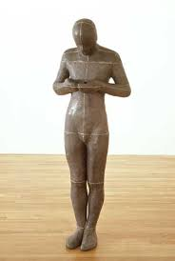
What is embodied experience?
Human beings have a body with certain perceptual and other characteristics: SELF vs. OTHER
We experience gravity: UP vs. DOWN; BALANCE
We are containers: IN vs. OUT
We encounter objects: COUNT vs. MASS, FIGURE vs. GROUND
Our bodies have symmetries/asymmetries: FRONT vs. BACK, LEFT vs. RIGHT
We sense distance: NEAR vs. FAR
We sense heat, light, pain, hunger, fear, etc.
We have control over our movements, eye-hand coordination, volition, etc. SOURCE-PATH-GOAL
We experience the flow of time

Slide 9
Embodied experience serves as the basis for grammatical categories
Meanings of cases and prepositions
Tense
Aspect
Modality
Person
Number
Possession

Slide 10
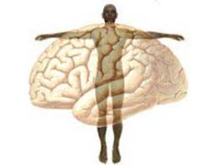

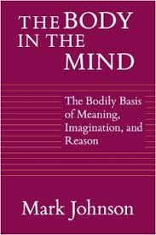
Our embodied experience
...is reflected in the dynamic connections in our brains

Slide 11
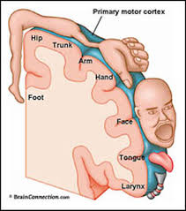
One example of the relationship between experience and the brain
The primary motor cortex of the brain contains a “map” of the body

Slide 12

Mirror neurons
Observation of an action automatically triggers simulation of that action in the brain
Neurons in the premotor cortex fire during both goal-directd actions and the observation of such actions
Mirror neurons provide a neural basis for imitation and empathy (inner imitation)

Slide 13

Construal in a lexical item
Russian: осминог
[eight-legs]
Norwegian: bleksprut
[ink-squirter]
Czech: chobotnice
[elephant-trunk-object]

Slide 14
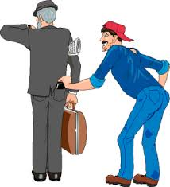
Construal in grammar
Harry stole John’s wallet.
John’s wallet was stolen by Harry.
John’s wallet was stolen.
A theft occurred.

Slide 15

Construal in Russian grammar
Разве что один из его дядей был учителем математики в школе. [Е. Д. Свердлов. Гениальность: гены? культура? стохастика? // «Вестник РАН», 2009]
― У меня только папа был хороший, он был учитель, его белые убили. [В. Ф. Панова. Спутники (1945)]

Slide 16

More construal in Russian grammar
Я у вас уже однажды спрашивала, влияют ли антибиотики на образование антител к ВИЧ. Вы ответили, что нет. И теперь у меня еще один вопрос...
Я у вас уже спросила, какова целесообразность высказывания моего мнения здесь?

Slide 17

Construal in Czech Grammar
Starý muž, Jaromír Nohavica
Až budu starým mužem budu staré knihy číst a mladé víno lisovat až budu starým mužem budu si konečně jist tím koho chci milovat koupím si pergamen a štětec a tuš a jako čínský mudrc sednu na břeh řeky a budu starý muž

Slide 18
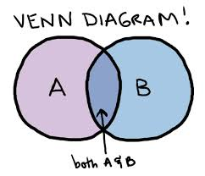
4 The Structure and Extension of Meaning
Human categorization uses radial categories, not Aristotelian categories
Prototype

Slide 19

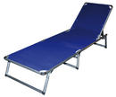
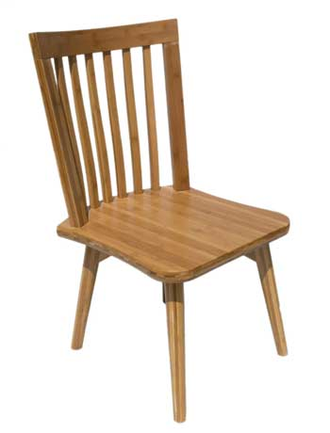
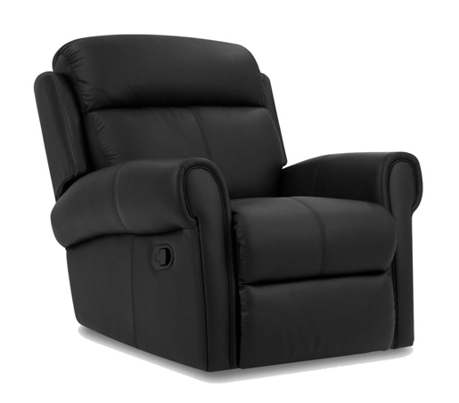
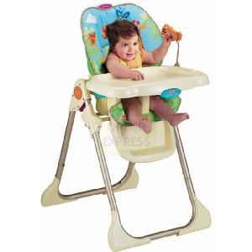
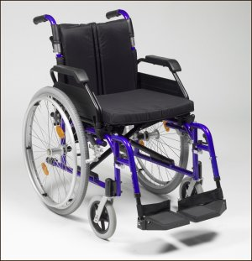
Furniture for sitting

Slide 20
If you speak English, your chair category looks like this:
rocking chair
lawn chair
high chair
chair
armchair
wheel chair

Slide 21
If you speak Norwegian, your chair category looks like this:
gyngestol
solseng
barnestol
stol
lenestol
rullestol

Slide 22
If you speak Czech, your category is:
houpácí
židle
lehátko
židlička
židle
křeslo
invalidní vozík /
kolečkové křeslo

Slide 23
Russian has two different categories:
кресло-
качалка
шезлонг
высокий стульчик
стул
кресло
кресло-каталка
(инвалидная коляска)

Slide 24
The take-home lesson about chairs:
Categorization isn’t “out there” in the world, reality can be categorized in different ways
Different languages can use different strategies for categorizing experience

Slide 25
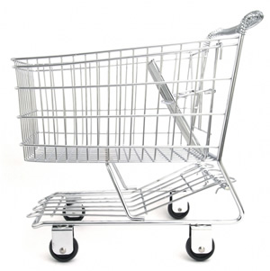
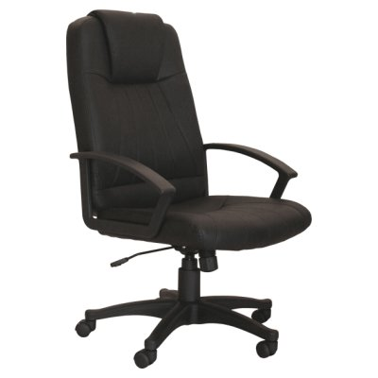
Which two items belong together?

Slide 26
How many of you chose this solution?

Slide 27
How many of you chose this solution?

Slide 28
Why did you choose the solution you did?
English: chair
Czech: křeslo (židle?)
English: wheelchair
Czech: invalidní vozík /
kolečkové křeslo
English: cart
Czech: vozík = ‘cart’

Slide 29
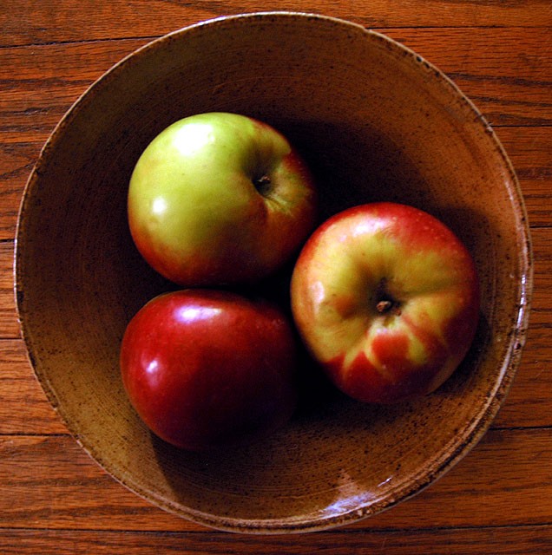
Think of all the ways that you could describe where the apples are

Slide 30




A: The apples are inside-bowl
B: The apples are loose fitting-bowl
C: The apples are concave valley that faces me-bowl
D: The apples are stomach-bowl

Slide 31
The take-home lesson about apples:
Meaning is based on embodied experience
Meaning is also present in “grammatical” phenomena such as functor words (like pre- and post-positions) and case
Because the lexicon and grammar are a continuum
Different languages can recruit different embodied experiences for this purpose:
Container vs. Surface, Tight vs. Loose fit, Topography, Body parts, etc.

Slide 32
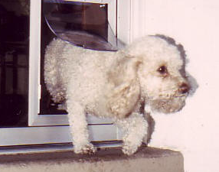
You are inside a house.
Suddenly a dog appears,
moving very rapidly
through the door.
How could you describe
what the dog did?

Slide 33
El perro entró corriendo
Hunden løp inn

Slide 34
The take-home lesson about dogs:
Meaning can be represented differently in different grammars
Verb-framed languages (like Spanish) focus on the path of motion, and the manner of motion is expressed optionally, as an adverbial
Sattelite-framed languages (like Norwegian) focus on the manner of motion, and the path is expressed in a particle or prefix

Slide 35
Some examples of linguistic categories that have the shape of radial categories:
Russian prefix raz-
Czech dative case
North Saami postposition čađa

Slide 36
Russian has:
1429 simplex verbs
that form 1981 Natural Perfectives
using 16 prefixes
Distribution of so-called “empty” prefixes

Slide 37
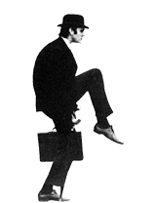
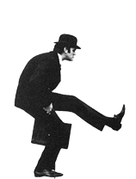

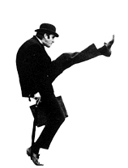
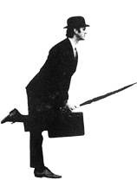
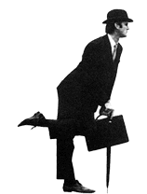
The schematic idea of raz-: APART, as in RAZojtis’ ‘walk in different directions’
John Cleese in the Monty Python sketch “Ministry of silly walks”

Slide 38
7. UN-
SP (38) razgruzit’ ‘unload’
Russian RAZ-:
Radial Category
1. APART
SP (38) raspilit’ ‘saw apart’
NP (22) razgryzt’ ‘gnaw apart’
2. CRUSH
SP (7) rastoptat’ ‘trample’
NP (5) razdavit’ ‘crush’
5. SOFTEN / DISSOLVE
SP (7) rastvorit’sja ‘dissolve’
NP (6) rastajat’ ‘melt’
4. SWELL
SP (3) razdut’ ‘inflate’
NP (9) raspuxnut’ ‘swell’
3. SPREAD
SP (30) raskatat’
‘roll out’
NP (17) razvetvit’sja ‘branch out’
6. EXCITEMENT
SP (29) raskalit’ ‘make red-hot’
NP (16) razgorjačit’ ‘heat up, irritate’

Slide 39
The Czech Dative Case
Schematic idea: A Dative entity is a potential subject, capable of a further action
D

Slide 40
The Czech Dative Case: Three Major Nodes
Dative: a receiver
(Indirect Object, etc.)
D
Dative: an experiencer
(Benefit, Harm, etc.)
Dative: a competitor
(Matched Forces, Submission, etc.)
D
D

Slide 41
Radial Categories Within the Radial Category Dative: a receiver
Giving messages: vyprávět ‘narrate’, kondolovat ‘express condolences’
Giving: dát ‘give’, poslat ‘send’, objasnit ‘explain’
Taking: vzít ‘take’, ukrást ‘steal’
Giving self: představit se ‘introduce oneself’, věnovat se ‘devote oneself’
Taking self: utéci ‘run away’, chybět ‘be lacking’

Slide 42
Radial Categories Within the Radial Category Dative: an experiencer
Age, environment, emotions, need: Kolik je vám let ‘how old are you’, je mi zima ‘I feel cold’, je nám líto ‘We feel sorry’, je ti to třeba ‘do you need that’
Benefit: prospět ‘benefit’, slušet ‘suit’
Harm: ublížit ‘harm’, vadit ‘bother’
Possession: umýt si ruce ‘wash one’s hands’, zlomit si nohu ‘break one’s leg’

Slide 43
Radial Categories Within the Radial Category Dative: a competitor
Submission: podrobit se ‘submit to’, pokořit se ‘surrender’
Matched Forces: podobat se ‘be similar’, rovnat se ‘be equal’
Domination: vládnout ‘govern’, vévodit ‘rule over’

Slide 44

North Saami postposition čađa ‘through’

Slide 45
North Saami postposition čađa ‘through’
Means: Girjji sáhtát diŋgot Davvi Girji o.s. čađa ‘You can order the book through Davvi Girji o.s. ’
Metaphorical motion: Son lea jođihan ohppiid álgooahppokurssa čađa ‘He had led the students through the introductory course’
Motion: viehkalii vuovdde čađa ‘he ran through the forest’
Fictive motion: E6-bálggis manná suohkana guovddáš osiid čađa ‘The E-6 highway goes through central parts of the municipality ’
Extent: bálggis vuovdde čađa ‘a path through the woods’
Time: Luohti lea rievdan ollu áiggiid čađa ‘The joik has changed a lot through time ’
Metonymic time: guhkes musihkka bihtáid čađa ‘through the long musical pieces’

Slide 46
5 Mental Spaces and Mapping: Metaphor, Metonymy, and Blends
Metaphor: mapping from source domain to target domain
Orientational metaphor: the extension of orientations such as IN/OUT, UP/DOWN, FRONT/BACK to non-spatial domains
Ontological metaphor: the conceptualization of non-things as if they were things, as in We are working toward peace, or His emotional health has deteriorated recently
Structural metaphor: takes an item with rich structure in bodily experience as the source domain for understanding something else. For example, PEOPLE ARE PLANTS in children sprouting up, youth as a blossom, old age as a time of withering and fading, and the slaughter of soldiers as being mowed down.

Slide 47
Orientational metaphor in Russian/Czech grammar -- Use of prepositions, case to describe non-spatial domains:
в три часа / ve tři hodiny ‘at three o’clock’
до одиннадцати / do jedenácté ‘by 11’
ответственность перед судом / odpovědnost před soudem ‘responsibility before the court’
через неделю / za týden ‘in a week’
ответить на его вопрос / odpovědět na jeho otázku ‘answer his question’
заплатить штраф за что-то / zaplatit pokutu za něco ‘pay a fine for something’
к утру / k ránu ‘toward morning’

Slide 48


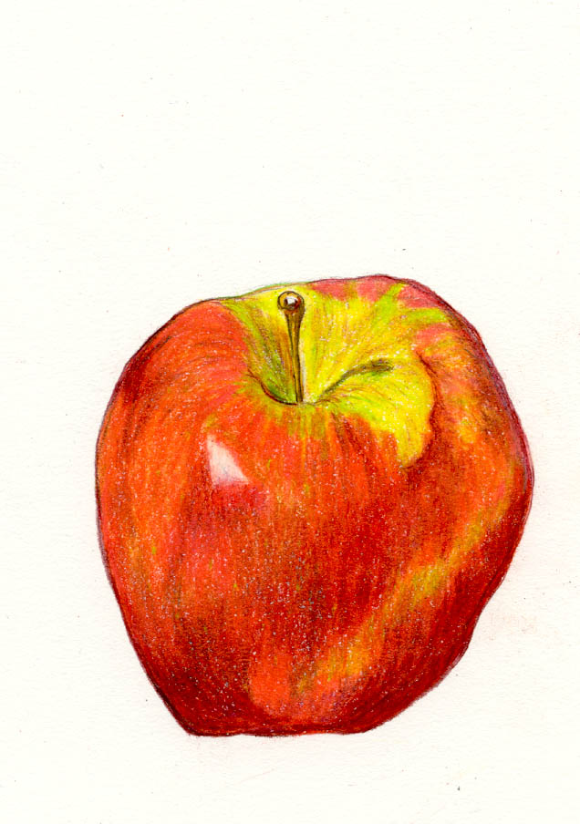
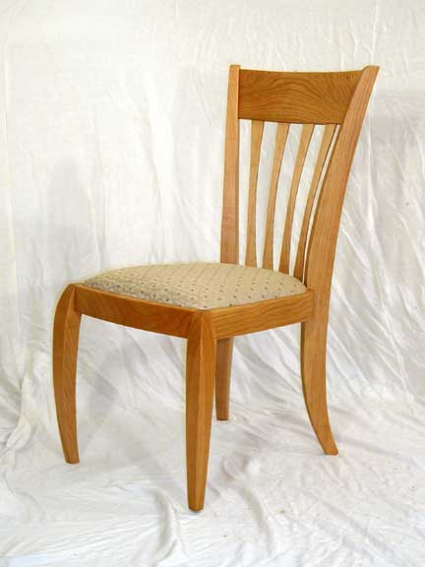


Structural metaphor in Russian/Czech grammar
Discrete Solid Object:
Fluid substance:
Perfective verbs
Imperfective verbs

Slide 49
Metonymy
Metonymy: when a source item stands in for a target item
Lexical metonymy: The ham sandwich wants his check. The White House has called for budget reforms.
Metonymy in grammar: ellipsis, truncation, and phonological reduction/neutralization; endpoint metonymy in Bill lives over the hill ; metonymy in word-formation

Slide 50
Metonymy in Russian/Czech grammar
Semelfactives:
чихнуть ‘sneeze once’ from чихать ‘sneeze’
Dative case:
дать ‘give’ > заплатить ‘pay’, ответить ‘answer’, помочь ‘help’, повредить ‘harm’
dát ‘give’ > zaplatit ‘pay’, odpovědět ‘answer’, pomoci ‘help’, nafackovat ‘slap’
Word-formation:
брюхо ‘belly’ > брюхан ‘person with a big belly’
květiny ‘flowers’ > květináč ‘flower-pot’

Slide 51
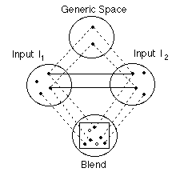
Blending
http://markturner.org/blending.html

Slide 52
6 Construction Grammar
Constructions (pairings of form and meaning) are THE units of language
Constructions are not necessarily strictly compositional
A language is a “constructicon”
“It’s constructions all the way down.” (Goldberg 1995)
Will show some examples of how grammatical constructions can be investigated using statistics in next section...

Slide 53
7 The Quantitative Turn in Cognitive Linguistics
Digital corpora
Statistical software
Linguistically interesting questions

Slide 54
?

Slide 55
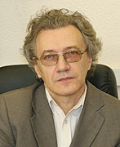
Constructional Profiles: SADNESS in Russian
Janda, L. A. & Solovyev, V. 2009. “What Constructional Profiles Reveal About Synonymy: A Case Study of Russian Words for sadness and happiness”. Cognitive Linguistics 20:2, 367-393.

Slide 56

Crash course in Russian case & SADNESS
Nouns are obligatorily case-marked
6 cases: Nominative, Accusative, Dative, Instrumental, Genitive, Locative
All cases can appear with a preposition
All cases except Locative can also appear without a preposition
70 constructions [(preposition) [NOUN]_{case}]
SADNESS: 6 near-synonyms, no “umbrella term”
grust’, melanxolija, pečal’, toska, unynie, xandra

Slide 57
Constructional Profiles: SADNESS in Russian
Big Questions:
What is the relationship between form and meaning?
➜What is the relationship between words and grammatical constructions?
➜What is the relationship between synonyms?

Slide 58
Constructional Profiles: SADNESS in Russian
Theoretical focus:
Can we measure the difference between synonyms in terms of distribution in grammatical constructions?

Slide 59
Constructional Profiles: SADNESS in Russian
Operationalization:
Constructional profiling: relationship between frequency distribution of grammatical constructions and meaning
➜SADNESS words vs. distribution in [(preposition) [NOUN]_{case}] constructions
Data: 500 sentences for each word from Russian National Corpus, Biblioteka Maksima Moškova
Statistics:
Chi-square, Cramer’s V effect size, Hierarchical Clustering (squared Euclidean distance)

Slide 60
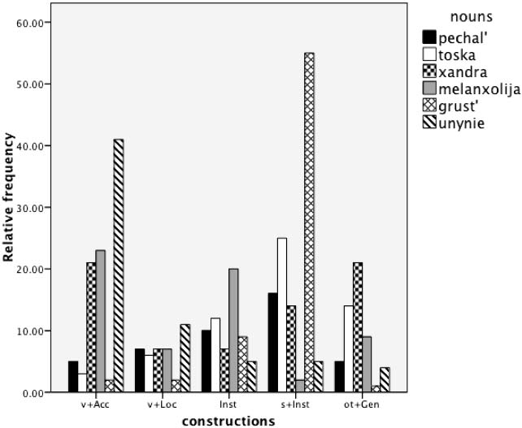
Chi-square = 730.35, df = 30, p < 0.0001, Cramer’s V = 0.305

Slide 61
‘Sadness’
Hierarchical Cluster
pečal’
toska
xandra
melanxolija
grust’
unynie

Slide 62
Constructional Profiles: Findings
Each synonym has a unique constructional profile
Some synonyms are closer together, others are farther apart

Slide 63
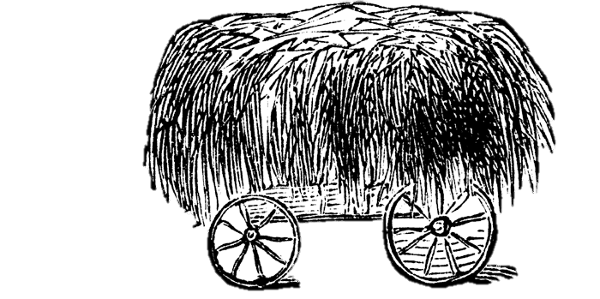
The Locative Alternation in Russian
Theme-object construction
gruzit’ seno na telegu
‘load hay onto the wagon’
Goal-object construction
gruzit’ telegu senom
‘load the wagon with hay’
Variables: VERB (prefixes), (passive) PARTICIPLE, REDUCED
VERB: unprefixed gruzit’ or prefixed: nagruzit’, zagruzit’, pogruzit’
PARTICIPLE:
Theme-object: seno gruženo na telegu ‘hay is loaded onto the wagon’
Goal-object: telega gružena senom ‘the wagon is loaded with hay’
REDUCED:
Theme-object: gruzit’ seno ‘load the hay’
Goal-object: gruzit’ telegu ‘load the wagon’

Slide 64
All non-passive forms
Past passive participles

Slide 65
The Locative Alternation in Russian
RIVAL FORMS: the two constructions, theme-object vs. goal-object
DEPENDENT VARIABLE:
CONSTRUCTION:
theme-object vs.
goal-object
INDEPENDENT VARIABLES:
VERB:
zero (for the unprefixed verb gruzit’) vs. na- vs. za- vs. po-
PARTICIPLE:
yes vs. no
REDUCED:
yes vs. no
DATA: 1920 sentences from the Russian National Corpus

Slide 66
Logistic regression model See Handout
Optimal model: CONSTRUCTION~VERB+REDUCED+PARTICIPLE+VERB*PARTICIPLE
The model estimates how the log of the number of theme constructions divided by the log of the number of goal constructions depends on the predictors. The coefficient of the estimate (Coeff.) is POSITIVE if the combination of factors predicts more theme constructions, but NEGATIVE if they predict more goal constructions

Slide 67
About the results...
Logistic regression shows a highly significant relationship between the construction and the following factors:
prefix
passive vs. active
reduced vs. full
Correlational strength is 0.796
Classificatory power: 88.5 % constructions are predicted correctly

Slide 68

TROLLing
is an international archive of linguistic data and statistical code
is built on the Dataverse platform from Harvard University and complies with DataCite, the international standard for storing and citing research data
is compliant with CLARIN, the EU research infrastructure for language-based resources
assigns a permanent URL to each post
uses metadata that ensures visability and retrieval through international services
is professionally managed by the University Library of Tromsø and an international steering committee

